Slide 1

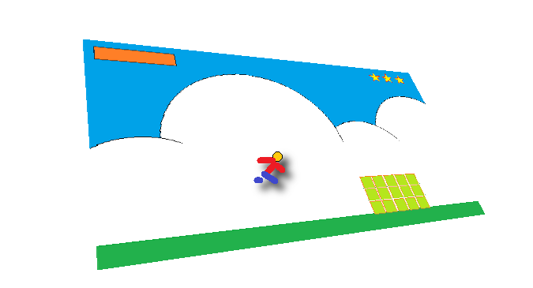
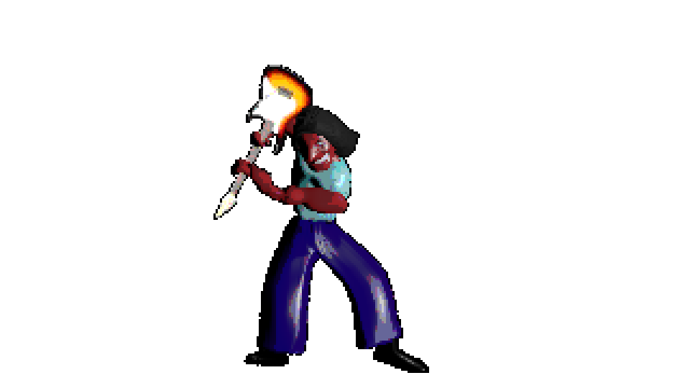
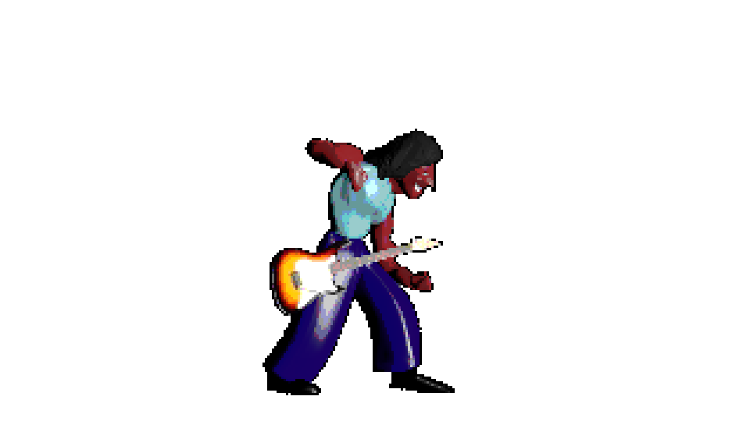
Using smartSpriteFX
Version Alpha 3.0
© 2016, 2017 - Atelier do Software
Developed by MGODOY

Slide 2
What’s smartSpriteFX?
smartSpriteFX is a component from open-source software suite smartSuite that joins free simple solutions to ease life of indie-games developers to spending less time in activities that normally would take several hours or would require a bigger team.
Know more in https://www.facebook.com/smartsuiteforindiegame/

Slide 3
What we can wait from this version?
That´s a Alpha version, that means which it isn’t a definitive version yet. You may find some bugs and several tools still aren’t available.
Stay in tune in https://www.facebook.com/smartsuiteforindiegame/ or in GitHub download page to be aware about releases.

Slide 4
Installation
First of all, choose a folder to host smartSpriteFX. Before open it at first time, check the requirements that your computer needs to have:
Windows 32 or 64 bit
Microsoft .NET Framework 4.5.2 installed
Unzip smartSpriteFX.zip in some folder. You are going to see several files. Just execute “smartSpriteFX.exe”.

Slide 5
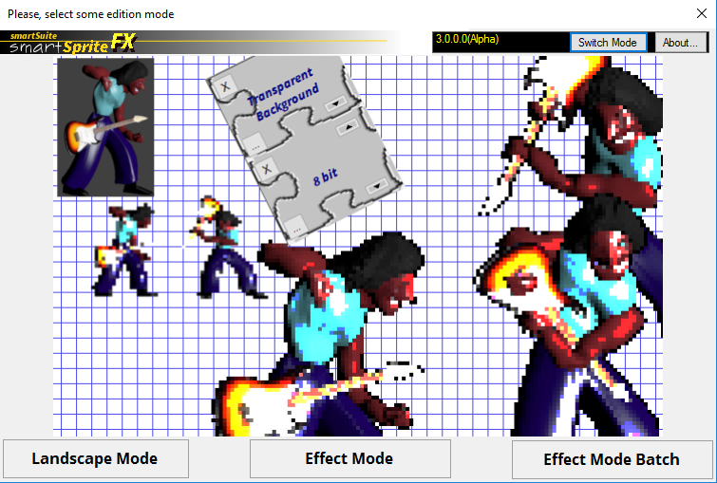
The Main Screen / Switch Mode
You can return to Switch Mode whenever you want, just clicking in shortcut in top of screen.
smartSpriteFX has the main screen called “Switch Mode”. Here, you can choose one modes:
Landscape Mode
Effect Mode
Effect Mode Batch

Slide 6
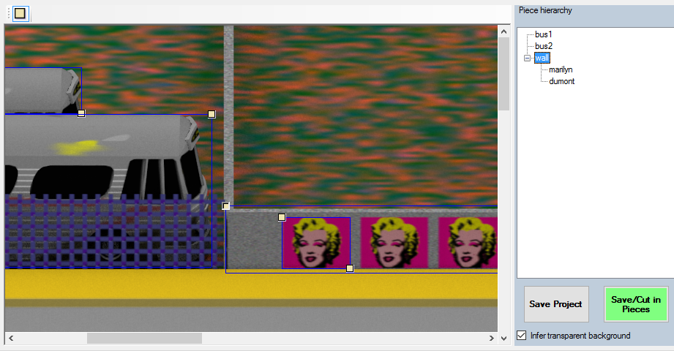
Landscape Mode is about cut piece of a image to create other images and use them like assets. Transparent background sometimes can be inferred. (detail Landscape Mode)

Slide 7
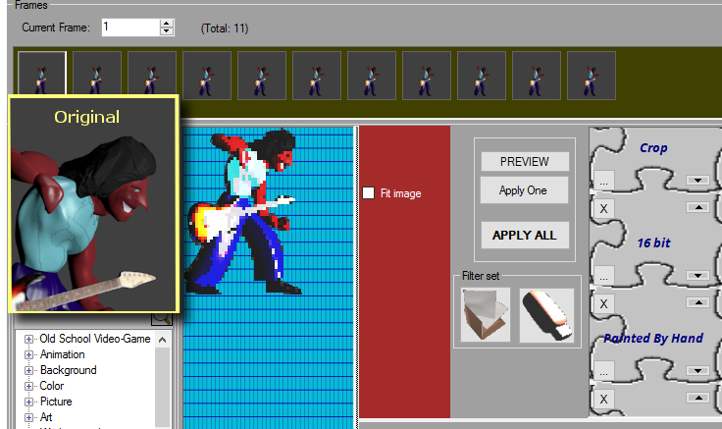
Effect Mode is about apply filters to a couple of images to get different effects. It´s perfect for animations. Differently from tradicional photo editor, you don’t have to use masks or layers, moreover, you can change the order of them to change the result. (detail Effect Mode)

Slide 8
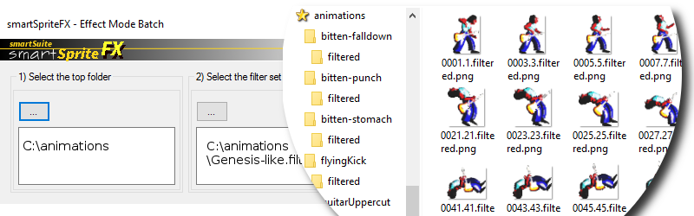
Effect Mode Batch allows apply a filter set from Effect Mode to severals folders at once. It´s perfect for animation assets. (detail Effect Mode Batch)

Slide 9
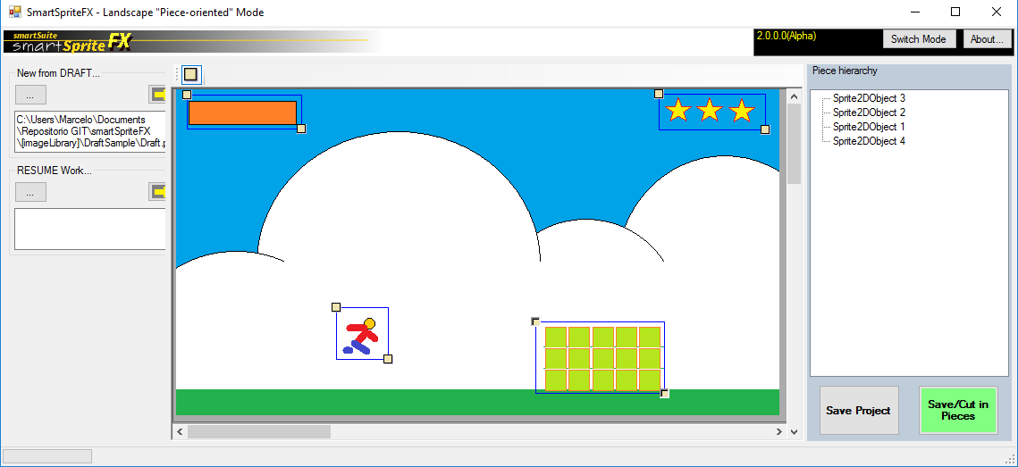
Landscape mode
Anchor ON/OFF
Opens new draft
Shortcut menu
Piece hierarchy tree
Resumes the project
Commands
Draft

Slide 10
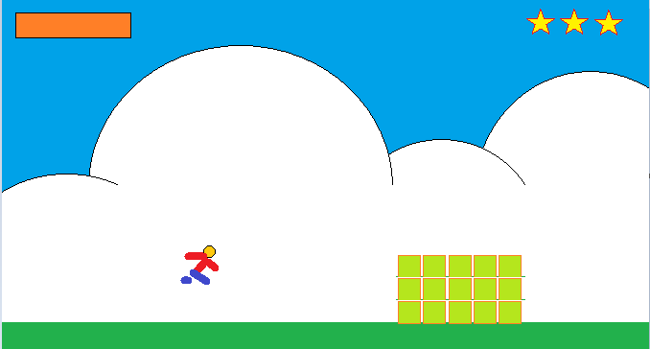
Prepare you draft
Prepare your draft anyway you want. I have created this in Paint Brush. You should include all detail that you want to have in your screen.

Slide 11
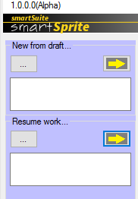

2) Start from draft
Create a new project using the draft created. Use “New from draft”
Save Project when you want to save to resume later.
Resume work when you want to resume again
To generate pieces to use in your game, use Save/Cut in Pieces.

Slide 12

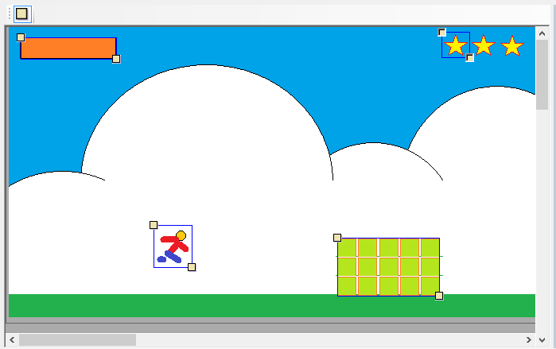
3) Indicate pieces
We call the little square in top of draft screen of “hook”. Use hooks to mark the pieces.
The system to mark them is based on hypotenuses. You just need mark the opposite points.
Do not forget to Save Project.

Slide 13
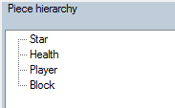
4) Organize yourself
A good tip is give name to objects. Use Piece hierarchy to provide them. Press F2 to change some name.
If you regret for create some object you can undo this remove it. Discover the object, marke it and press DELETE key.
Remember: don’t forget to Save Project after any changes!!!!

Slide 14
5) Save/Cut in Pieces
When you like to generate pieces, use Save/Cut in Pieces.
During the process, smartSpriteFX can have some doubts about the decision about the background in pieces. So, stay in touch during this process, because I can ask you something.

Slide 15
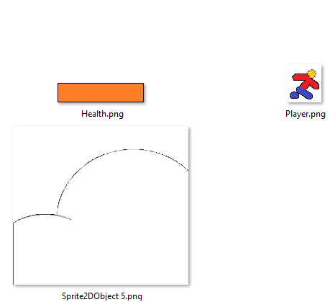
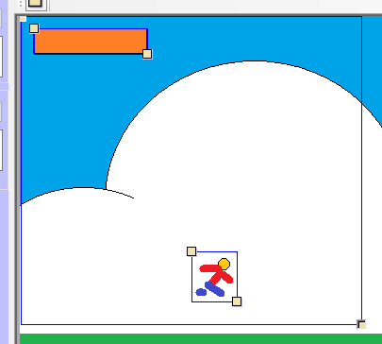
Pieces can be created inside of others
When this happens, smartSpriteFX will overcover the space without the pieces!!

Slide 16
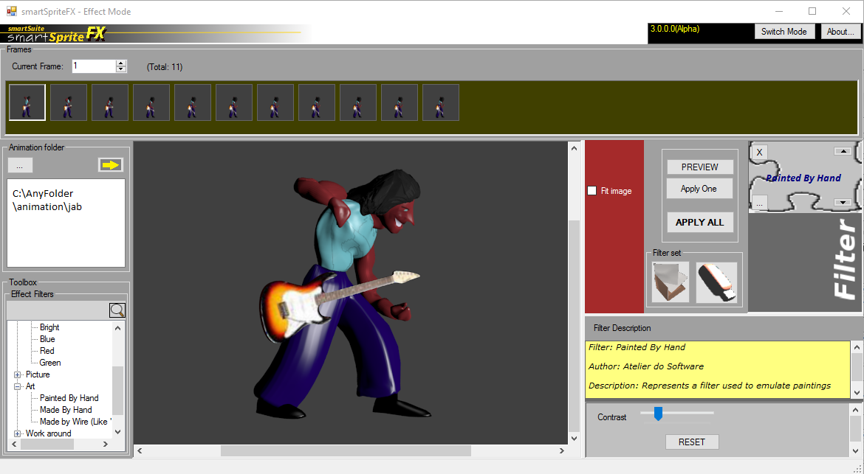
Effect mode
Shortcut menu
Frames
Fits frame in preview board
Filter box and commands Preview, Apply One and Apply All
Opens the animation folder
Save or open a filter set. You can use them in Effect mode batch as well
Filter pallet. You can search through tree or writing the name on space. Double click to add it in Filter Box
Preview board
Filter configuration panel

Slide 17
1) Prepare your animation
In smartSpriteFX, an animation is a folder contained several images. For practical reason, we starting to call them frames.
The frames doesn't need to refer each other.
You can create them anyway you want. Here, we create them in Blender from animation in 3D.
Blender is a 3D open-source software developed by Blender Foundation

Slide 18
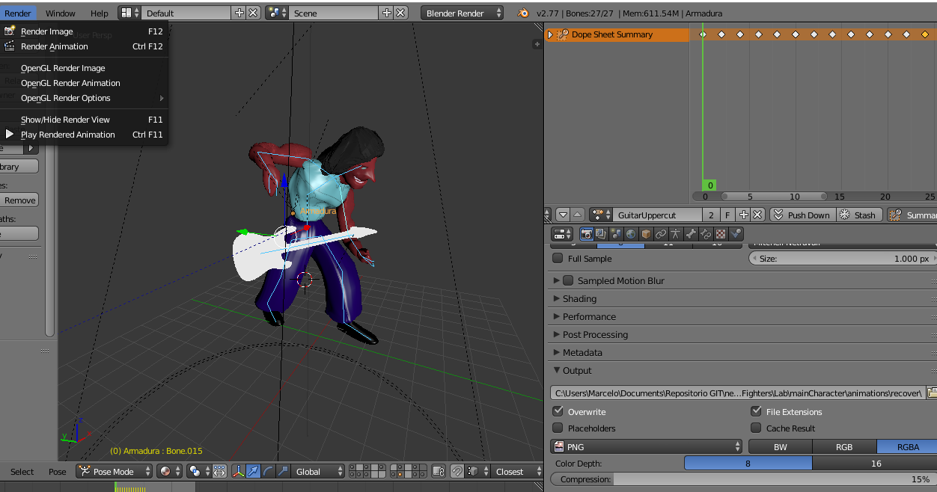
Quick explanation about Animation in Blender...
In Render menu, you can Render animation. That is the last thing that you are going to do
The moves (position of bones) can be grouped like “Actions”, Here you have a time line
You create objects and skeletons (called “armature”). You move the bones around the axis along the key frames to create animation
This menu you configure the output folder. Here you chose “PNG” like output. Memorize that folder, because you are going to use in smartSpriteFX.

Slide 19
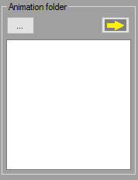
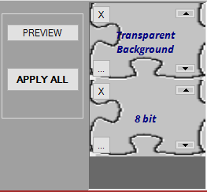
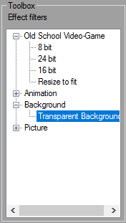
2) Proceed to smartSpriteFX and choose “Animation-oriented” mode
Select the folder which contains the images
After that, note the Toolbox/Effect filters. It will have filled with filters. Open a group and give a double-click over it to select a filter that you desire.
Note the right panel. The selected filters will show up. You can remove them if you want.

Slide 20
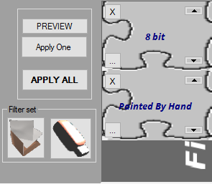
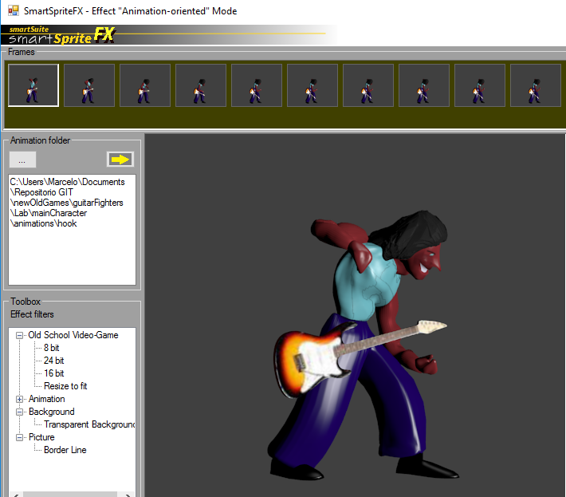
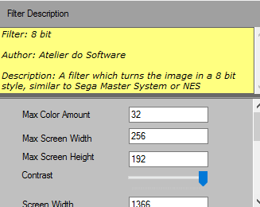
3) Select a frame, configure filters,and...
Change the filter order. This can complete change the result
You can see a summary about the function of filter and configure some attributes, according to the filter

Slide 21
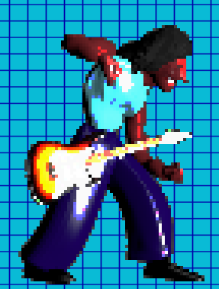
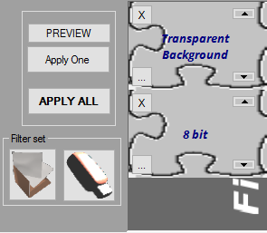
4) … preview the result
Have you liked what you see? Save the filter set to use reuse it.

Slide 22
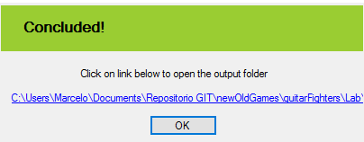
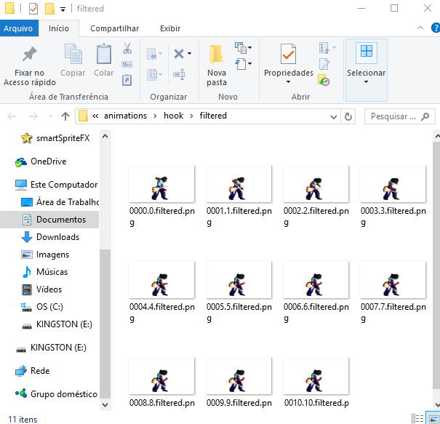
5) Apply over the entire animation!
Wait for conclusion. Click over the link
The original images are never overwritten. To get the result of applying, the result are generated under filtered folder.
Apply the filters.
- Apply One: Just the current
- Apply All: all the frames
See the new images!!

Slide 23
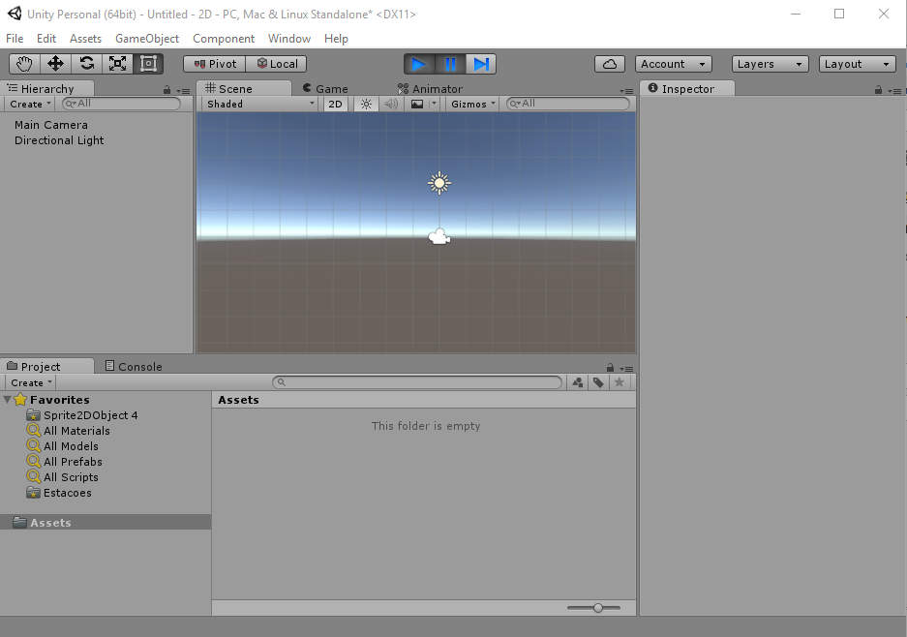
6) Import the filtered images to Unity
1) Create a 2D Unity project
2) Drag and drop all the filtered images to some Asset folder in Unity

Slide 24
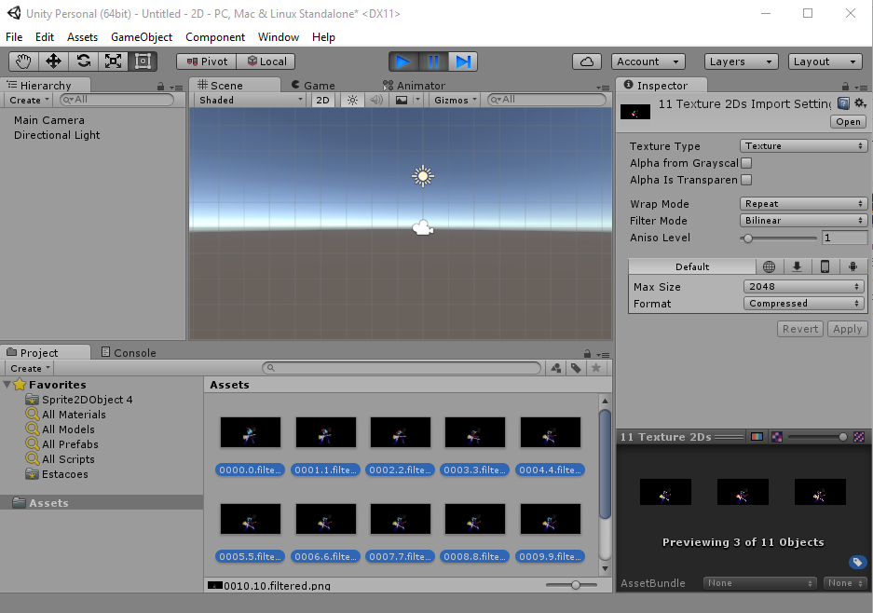
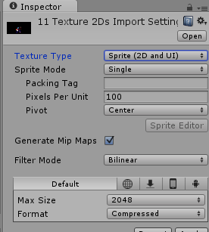
7) Signs all the images to Sprite (2D and UI)
Check for the correct pixel per Unity. It´s common the value be to big. Reduce it to 3 or 5

Slide 25
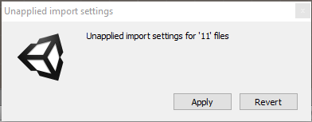
8) Click in assets and confirm import settings
Click in any place in asset folder to see the question.
Confirm “Apply” and wait

Slide 26
8) Click in assets and confirm import settings
Click in any place in asset folder to see the question.
Confirm “Apply” and wait

Slide 27
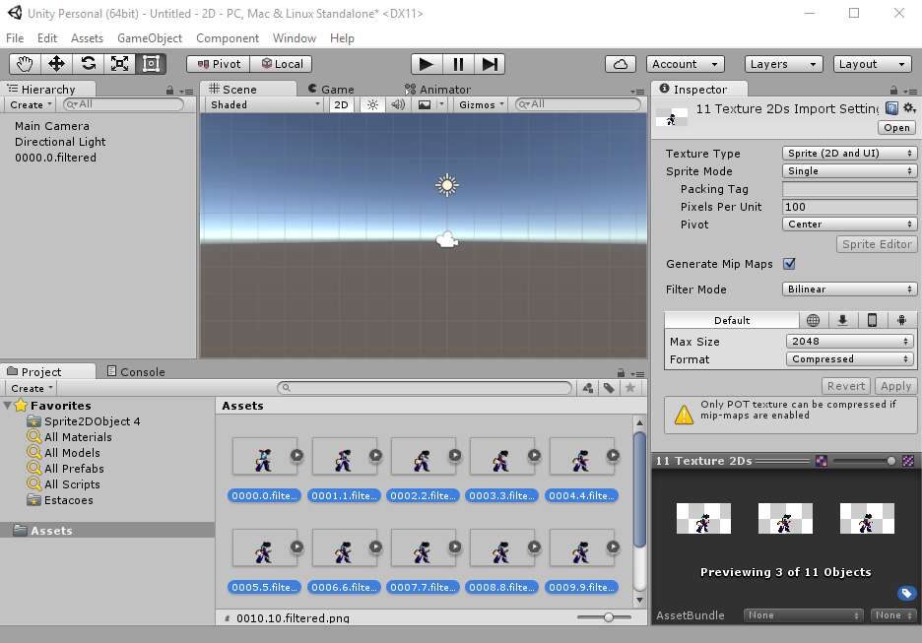
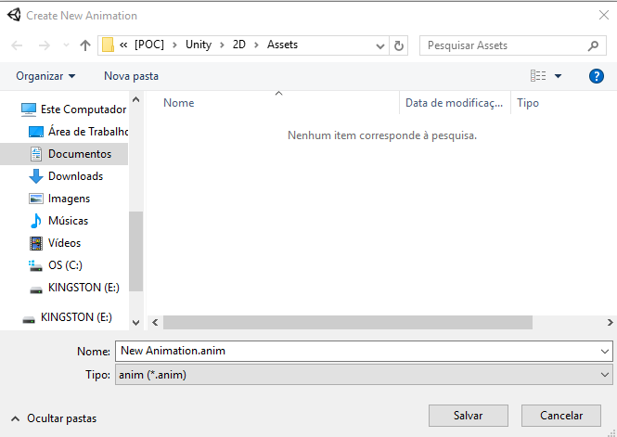
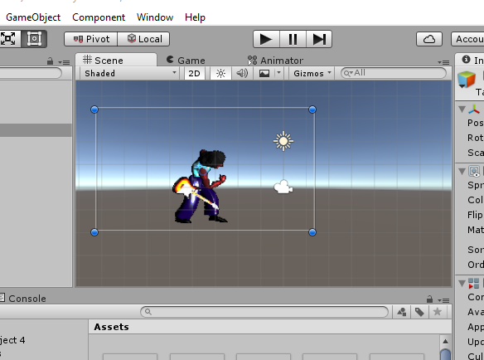

9) Select all images and drag and drop to scene
Drag and drop all images to scene
Save animation
Play to see the animation!!!!
Learn deeply how to handle 2D animations with Unity Tutorials: https://unity3d.com/pt/learn/tutorials/topics/2d-game-creation/2d-character-controllers

Slide 28
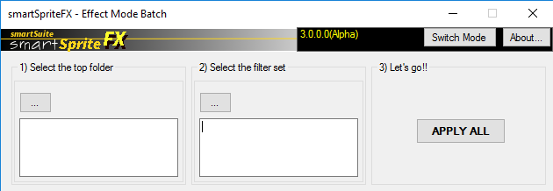
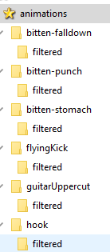
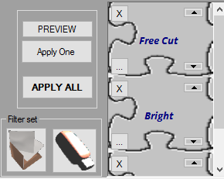
Effect mode batch
Apply the filter set in all folders under the top folder
Select the top folder
Select a filter set (Filter sets are created in Effect mode)

Slide 29
Appendix – Going further in effect
Effect filters can be incremented with new effects.
Official and third-party effects can be added. You also can create you own effects if you had ability in programming.
Third-part effects should be placed in ThirdPartyEffectModulePlugin folder.
The documentation to explain how to implement new effects will be available soon.

Slide 30
Be aware of news:
https://m.facebook.com/smartsuiteforindiegame/
Blender, Unity, Visual Studio and C#, NES / SNES, Nintendo, Sega Master System and Sega Genesis are trademark of their respective owners.

